Slide 1

Advantages of enabling the SQL IaaS extension

Slide 2
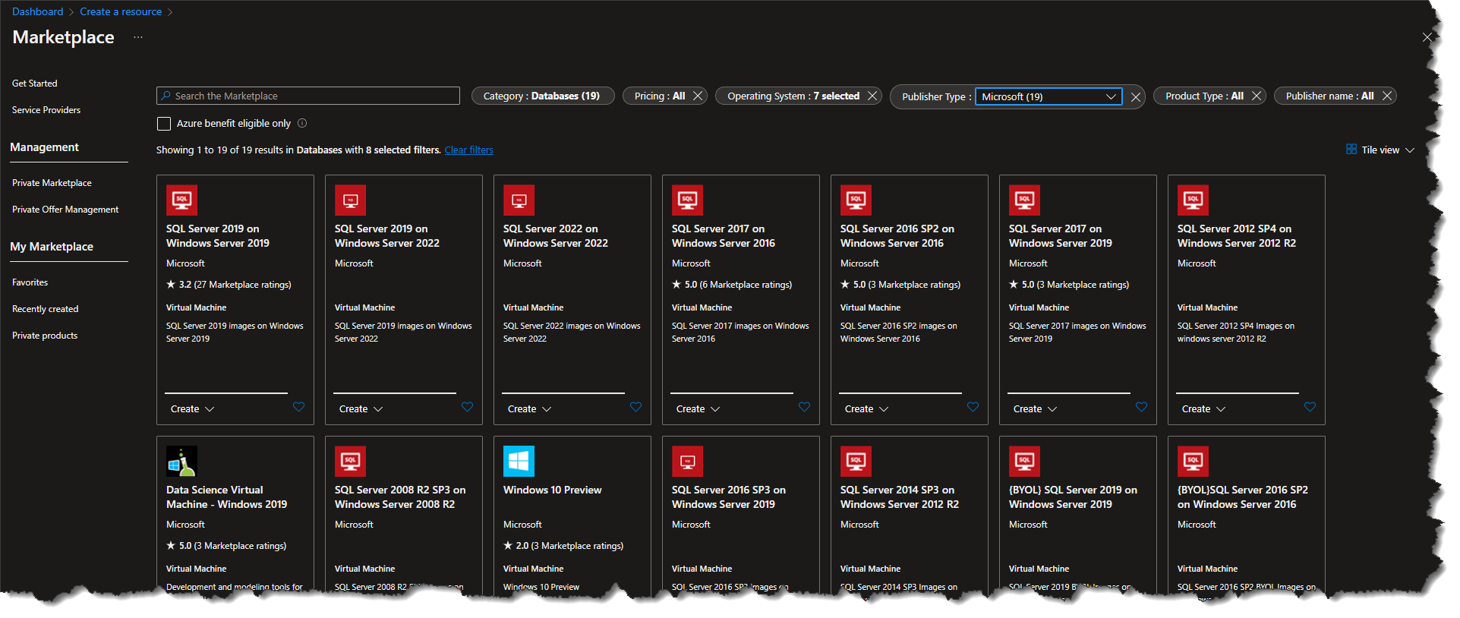

Slide 3
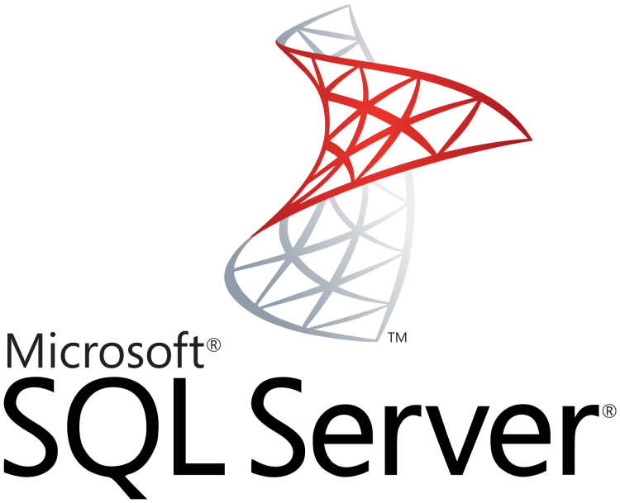


Slide 4
SQL Server IaaS Agent Extension benefits
For customers: SQL Server on Azure Virtual Machines saves money and simplifies management of security, high availability, and storage administration
Optimize cost | Enhance Security | Boost uptime | Simplify management
See all your SQL Server on Azure VMs in one location, convert between license types, and save by paying only for what you use. | Manage security patching and easily implement encryption features for better security and compliance. | Automate backup, easily configure high availability, and take advantage of HA/DR license benefits to enhance business continuity. | Automatically implement storage best practices and configure your storage settings more optimally for SQL Server.
Inventory Management: Counts licenses of different types and helps you understand your data estate. Flexible licensing: Enables immediate conversions between PAYG and Azure Hybrid Benefit (AHB) as well as between Developer and Enterprise edition. In-place edition updates: Enables upgrades or downgrades of SQL Server edition for supported upgrade paths with no availability impact. | Automated Patching: Automates installation of SQL Server Security updates within customer defined maintenance window. Azure Key Vault Integration: Enables customers to configure Azure Key Vault for the SQL Server instance to leverage Key Vault for Transparent Database Encryption(TDE), Column Level Encryption and Always Encrypted. | Automated backup: Sets up SQL Server backups with various options. Automated high availability configuration: Enables customers to configure Always On availability groups for SQL Server on virtual machines. Disaster Recovery license type: Leverage SQL Server HA/DR Software Assurance benefits in Azure. Enable using Azure as a Disaster Recovery site for your on-premises SQL Server. | Automated storage management: Simplifies storage configuration while setting up the virtual machine using pre-configured storage. Centralized administration: Easily manages your SQL VM and SQL PaaS deployments from one central location. Implement best practices: Enables you to deploy SQL Server with pre-configured best practices.

Slide 5
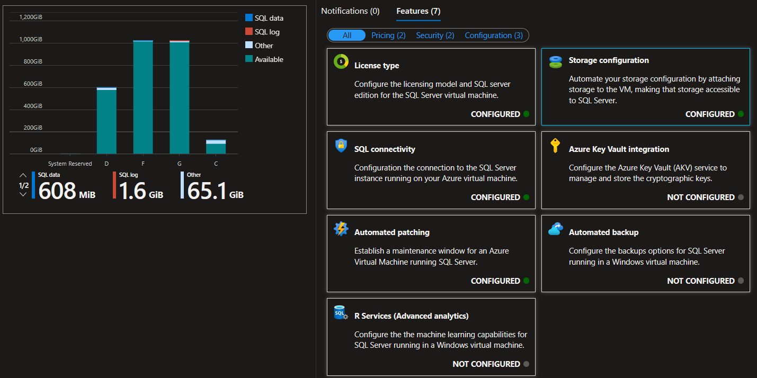

Slide 6
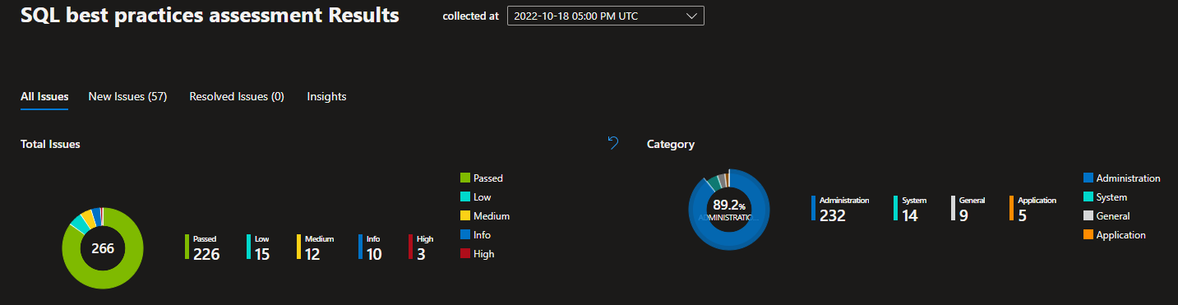
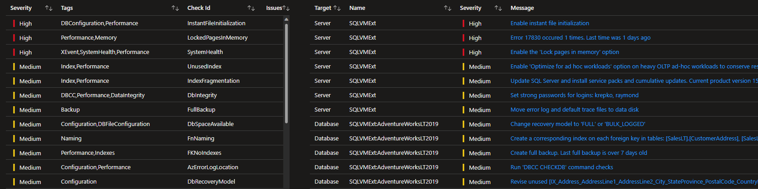
Automate SQL best practices assessment

Slide 7
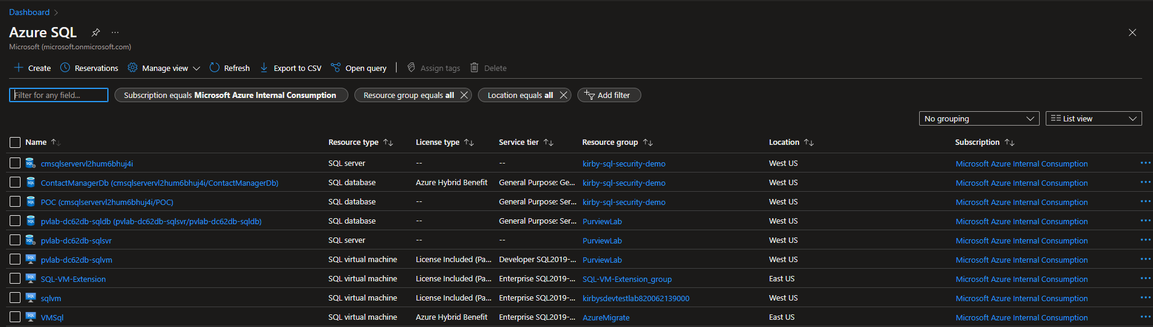
One view for all your SQL resources

Slide 8
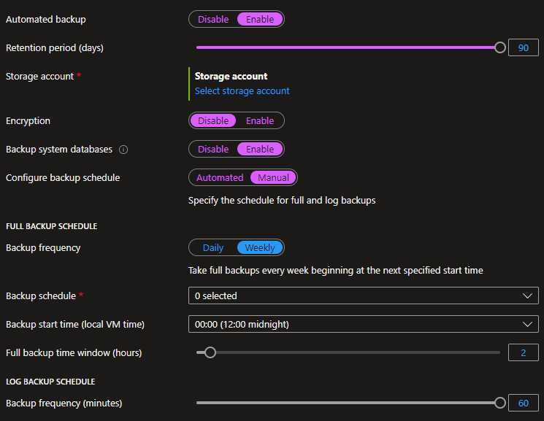
Automated Backups

Slide 9
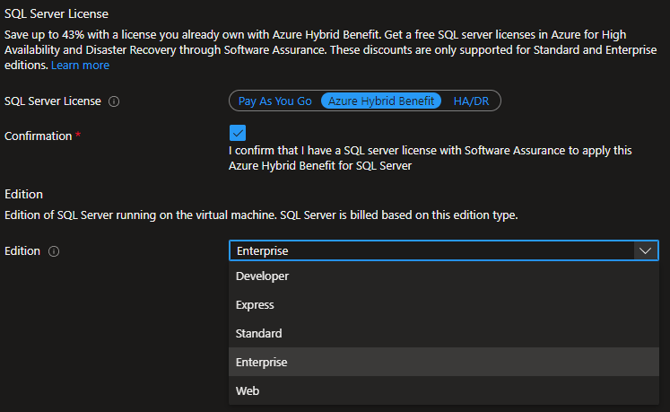
Change license types

Slide 10
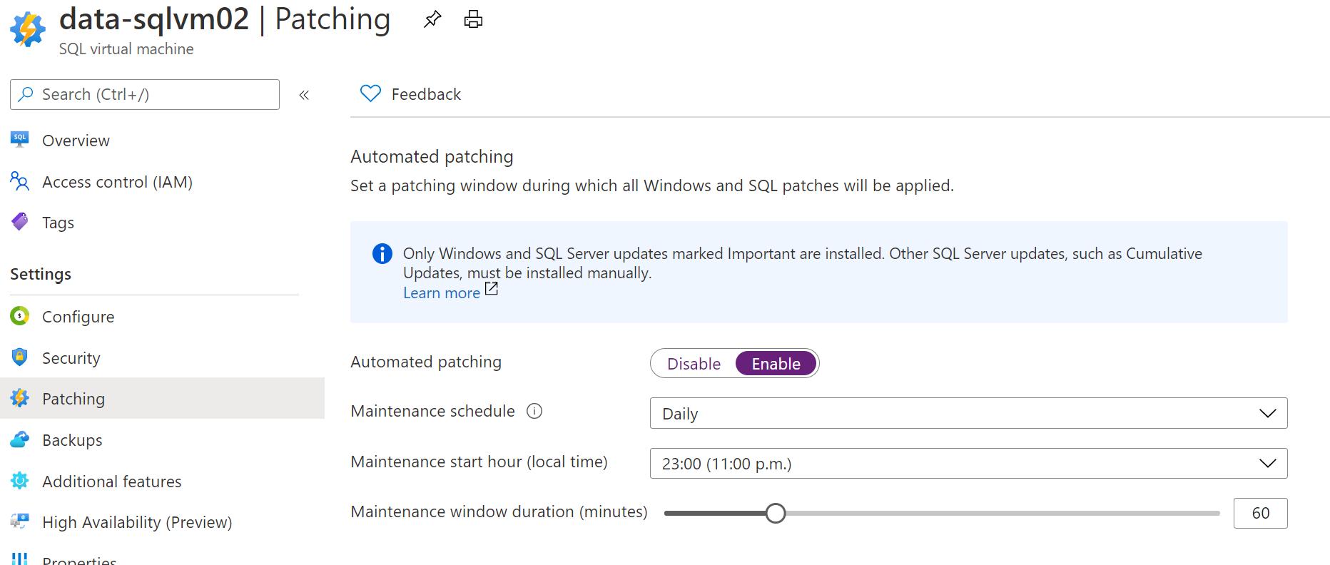
Azure SQL IaaS Extensions - Automated Patching Feature
The Automated Patching feature allows a SQL Server administrator to select a maintenance window schedule for applying Important Windows Server and SQL Server updates that are distributed through the Windows Update channel.
Notes:
Security is a key area of interest for any database administrator who is responsible for securing and protecting business data stored in a SQL Server database. Sometimes compliance requirements drive security needs like encryption of data at rest. SQL Server on Azure Virtual Machines make security management easier through patching and easily implement encryption features for better security and compliance.
Extended support for SQL Server 2008 and SQL Server 2008 R2 ended on July 10, 2019. Customers that have SQL Server 2008 R2 and SQL Server 2008 can upgrade to a newer version of SQL Server or migrate to Azure SQL Database or Managed Instance. There is also an option for customers to stay protected using Extended Security Updates for SQL Server 2008 or SQL Server 2008 R2. This is available for Free and enabled by default when migrating on-premises servers to SQL Server on Azure virtual machines. This provides you the ability to receive a critical security update when one is released or receive technical support for SQL Server 2008 or SQL Server 2008 R2 with your existing support plan without having to purchase Extended Security Update subscriptions.

Slide 11
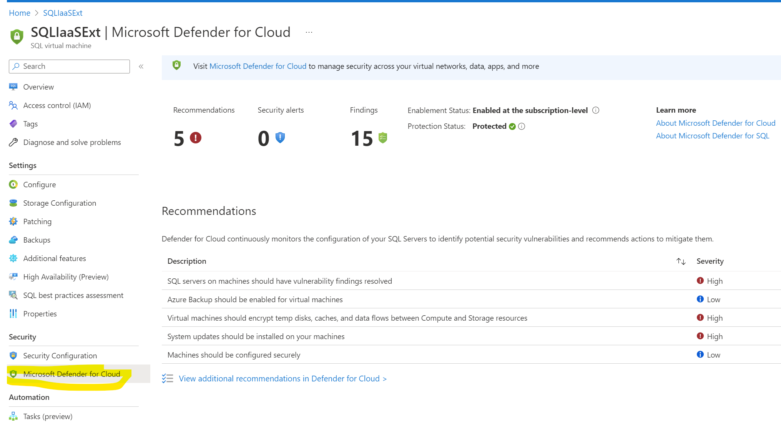
Get security recommendations right in your SQLVM blade
Notes:
In addition to the above benefits, SQL Server on Azure virtual machines also offer you the ability to
detect anomalous activities indicating unusual and potentially harmful attempts to access or exploit databases. You'll see alerts when there are suspicious database activities, potential vulnerabilities, or SQL injection attacks, and anomalous database access and query patterns.

Slide 12
Azure SQL IaaS Extensions - management modes
Registering with the SQL Server IaaS Agent Extension automatically installs the SQL Server IaaS agent extension in one of three management modes, specified during the registration process. Not specifying the management mode will install the SQL IaaS agent extension in full management mode.
Lightweight
Does not require the restart of SQL Server
Supports only changing the license type and edition of SQL Server
Use this option for SQL Server VMs with multiple instances, or participating in a failover cluster instance (FCI)
No impact to memory or CPU
No associated cost
It is recommended to register your SQL Server VM in lightweight mode first, and then upgrade to Full mode during a scheduled maintenance window.
Full
Does not require the restart of SQL Server
Supports all functionality
Use it for managing a SQL Server VM with a single instance
Installs two windows services that have a minimal impact to memory and CPU
No associated cost
NoAgent
Dedicated only for SQL Server 2008 and SQL Server 2008 R2 installed on Windows Server 2008
No associated cost

Slide 13
Enabling these features

Slide 14
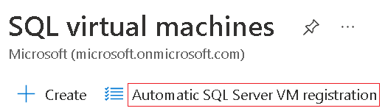
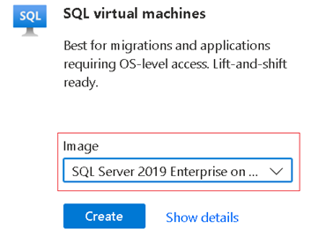
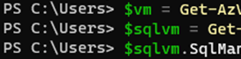
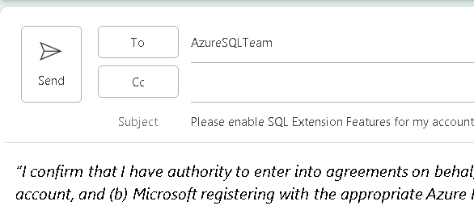
Enabling the features are easy
Click the button in Portal
One click can enable it for your subscription
Select an Azure Image on creation
Features are turned on by default
Use the command line
PowerShell automates it, we provide the scripts
Ask us to do it for you!
We’ll provide an email template that you “sign”,
then we enable on the back-end
Opt-in during your install of SQL Server
This is your “Error and Usage Reporting” screen
If the customer is up for renewal
M910 addendum can be added

Slide 15
Email wording
“I confirm that I have authority to enter into agreements on behalf of Northwind Database Company. On behalf of my organization, I consent to (a) Microsoft retrieving the list of Azure subscription IDs associated with my [ORGANIZATION or ENROLLMENT – pick 1 of 2 option] Azure account, and (b) Microsoft registering with the appropriate Azure Resource Provider all existing and future SQL Server instances installed on virtual machines, Linux containers or physical servers running in Azure or connected to Azure via Azure Arc in all subscription IDs associated with the agreement under which my organization obtained Azure services.”

Slide 16
Questions

Slide 17
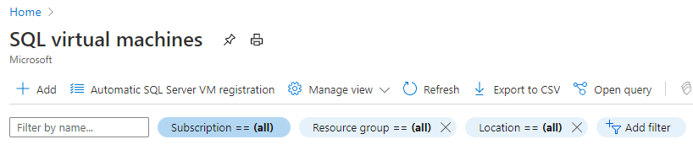
Bringing PaaS like features to Azure SQL VM
Features of SQL IaaS Extensions | Extensions not enabled | Extensions enabled
 |  | Lightweight mode | Full mode
Visibility to the SQL Server VM estate (editions, configuration state) via Portal Management
Visibility to the licensing of SQL Server instances (switch between PAYGO and AHB, included HA/DR license)
Unified Management View (SQL VM/PaaS deployments management in one location)
SQL Server integration with Azure Key Vault (Encryption keys storage)
Automatic configuration of Always On for High Availability (creation of availability group with CLI or UI)
Automated Patching (configuration PaaS like for installation of critical updates)
Automated Backup (configuration PaaS like with Point-in-Time Restore)
Disk Scaling and Utilization view (Resize Data and Log disks from Azure Portal)
If Azure Defender for SQL is enabled, Security Center recommendations are visible directly in SQL Virtual Machines resource view in Azure Portal
Automatic SQL Server VM registration button enables SQL IaaS Extensions features for all SQL VMs within a given subscription automatically.
In order to activate this feature for multiple subscriptions, the bulk action script is available.
Activation will require consent of the person who performs activation.
The request for customer consent enables to-customer statement in the opt-in that data can’t be used for audit unless the customer agrees: “Microsoft will not use this data for licensing audits without customer’s advance consent.”.
The SQL IaaS extensions will become active for all SQL Server VMs, and the features of lightweight mode will be activated within 24 hours after the activation.
Registering extension in full mode does not require restart of the server.

Slide 18
SQL Server IaaS Extensions - Lightweight mode as first step
First step is to enable Lightweight mode only
Lightweight Mode (default): Enable consent for the DEV, QA and other environments to have better visibility. Validate: Observe the environments for the period of 2 weeks, at the same time review and validate scripts that can automate auto registration for bulk numbers. Identify candidate subscription for production enablement (still in the lightweight mode only). Enable lightweight in staging and production: Using script, enable auto registration on the list of given subscriptions. The enablement will take up to 24 hours to register all SQL instances. Address any issues. Reporting: Incorporate information about SQL Server licenses, editions for better visibility. Upon successful completion of the first step, your organization will immediately realize value of the SQL IaaS extensions by understating the real estate of SQL VMs, leveraging AHB benefits, ability to access SQL configuration management in a consistent PaaS like way. As your organization will complete enablement of the lightweight mode across all subscriptions, the planning and implementation of the second phase “Full Mode” could be taking place. Moving from lightweight mode to full mode will require manual or scripted enablement of the Full Mode for each of the registered SQL server VM instance. Registering extension in full mode does not require SQL server restart.
Azure SQL IaaS Extensions - single and bulk registration
There are multiple additional options how SQL Azure VM Extensions could be registered. Automatic registration for multiple subscriptions could be done by leveraging PowerShell script (provided) Single VM registration is also available via Azure Portal or Azure CLI/PowerShell If it is required to reinstall or unregister extension, it could be done via Azure Portal or Azure CLI/Azure PowerShell scripts for a single VM or bulk

